Slide 1

Basics of Programming
https://moodle.ucl.ac.uk/course/view.php?id=22765

Slide 2
Basics of Programming
Why program in MATLAB?
Allows you to keep a record of the commands you have executed
Promotes transparency and reproducibility of your analyses
Saves time if you are running multiple lines of code more than once
Does not require constant attention!
Excellent built-in debugging and straightforward syntax

Slide 3
Relational and Logical Operators
But before we get started!
We will need to know about several common relational and logical operators:
== ‘is equal to’
< ‘less than’
> ‘more than’
<= ‘less than or equal to’
>= ‘more than or equal to’
~= ‘not equal to’
& ‘and’
| ‘or’

Slide 4
Creating a Script
Start a new script by clicking on “New script”, typing ctrl+N, or File -> New -> Script
This opens the scripting / Editor screen
You can now start to program!
A MATLAB script is essentially a stored list of commands to be executed
These scripts are stored as *.m files, which are essentially text files

Slide 5
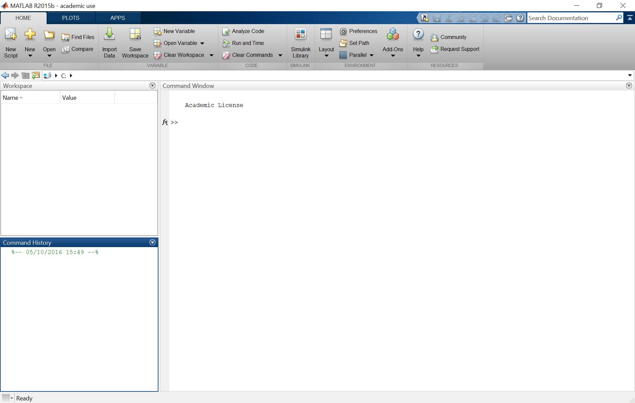
Creating a Script
New script

Slide 6
Executing and Annotating a Script
In the simplest case, we can just type out a series of commands and save them
The whole m-file can then be executed by clicking on “Save and run” or pressing F5
It is good practice to annotate or comment on your code
This helps you to follow what your code is doing, step by step
This also helps other people to understand your code
Comments can be entered by prefacing with %

Slide 7
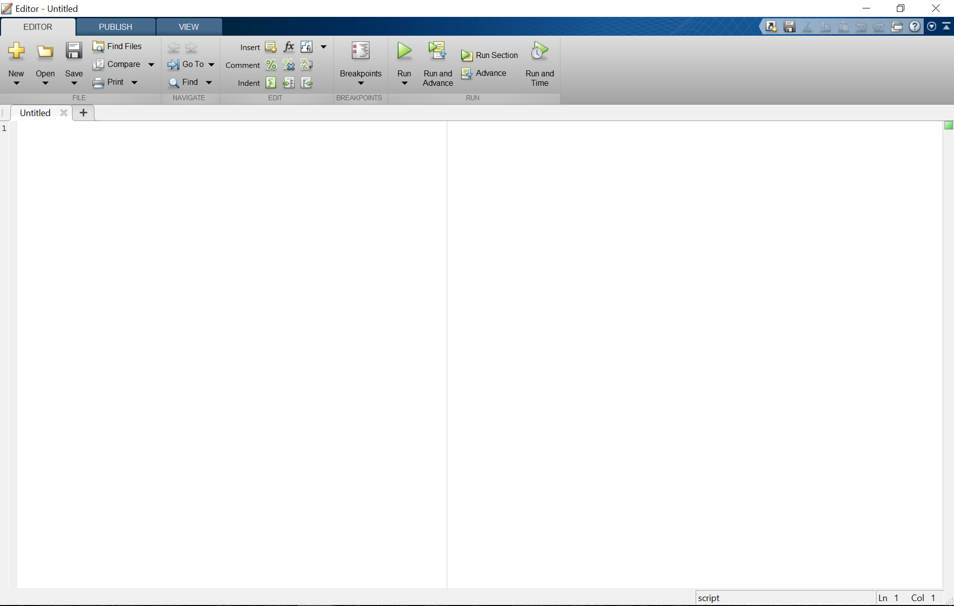
Executing and Annotating a Script
Save and run

Slide 8
Memory Management
Scripts can use variables that currently exist in the workspace
Any variables created within the script are output to the workspace
Note: you can only run scripts from your current folder or the MATLAB ‘path’
The path is a list of folders that MATLAB will search for scripts and functions in
You can change the current folder using the bar above the command window
You can add / remove / change the order of folders on the path by clicking ‘Set Path’
You can find the location of any script on the path by typing which script_name

Slide 9
Memory Management
Edit the Matlab search ‘path’
Change the current folder

Slide 10
Loops and Conditional Statements
More advanced programming makes use of loops and conditional statements
Loops are used to execute the same piece of code multiple times
e.g. if you wish to run the same piece of analysis on each participant’s data
Conditional statements use relational / logical statements to select what code to run
e.g. if you wish to run different analyses on data from different groups
The most important shortcut in MATLAB: ctrl+c
This terminates any ongoing loop

Slide 11
‘If’ Statements
The most common conditional statement is an ‘if’ statement
Use this if there are sections of code that you only want to access IF something is true
‘if’ statements must always be terminated with an ‘end’ statement
You can then introduce alternative outcomes with an ‘else’ or ‘elseif’ statement
if condition1
…
elseif condition2
…
else
…
end
Be wary of the difference between ‘elseif’ and ‘else if’
‘else if’ enters a new or ‘nested’ loop of ‘if’ statements

Slide 12
‘Switch/Case’ Statements
Alternative outcomes can also be selected with a ‘switch / case’ statement
‘switch/case’ statements can only be used to evaluate a single variable
‘switch/case’ statements are (almost) equivalent to a series of ‘elseif’ statements
‘switch/case’ statements are often used to evaluate strings
An alternative is to use the function ‘strcmp’
‘switch/case’ statements must always be terminated with an ‘end’ statement
switch variable
case option1
…
case option2
…
end

Slide 13
‘For’ Loops
If you want to repeat an operation multiple times, use a ‘for’ loop
The loop is executed ‘for’ each of the entries in a loop counter
In some cases, the loop counter is superfluous to the code within the loop
In other cases, the code is executed using each value in the loop counter
‘for’ loops must always be terminated with an ‘end’ statement
for count = 1 : n
output(count) = command(count);
end
clear count
It is also generally good practice to ‘clear’ your loop counter
‘for’ loops can also be nested

Slide 14
‘While’ Loops
If you want to repeat an operation until a condition is satisfied, use a ‘while’ loop
The loop is executed ‘while’ waiting for the condition to be satisfied
Hence, the conditional variable must be updated within the loop
‘while’ loops must always be terminated with an ‘end’ statement
while condition(variable)
update variable
end
It is easy to get stuck in an infinite while loop (remember ctrl+c!)

Slide 15
Writing Functions
Any script can be converted to a function using the following title line:
function[output1 output2 …] = function_name(input1, input2, …)
Unlike scripts, functions use their own ‘private’ workspace
Any required input must be passed directly to the function
Only assigned output will be delivered to the (base) workspace
Help information can be entered in comments at the top of the function script

Slide 16
Any Questions?
d.bush@ucl.ac.uk

